Slide 1

ARTIFICIAL INTELLIGENCE
&
MACHINE LEARNING
SESSION NO :33

Slide 2
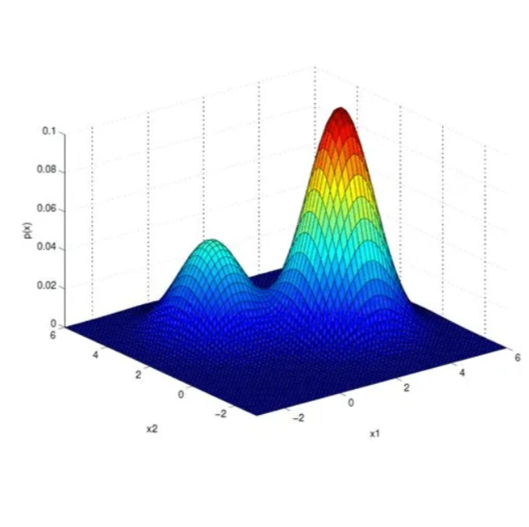
Gaussian Mixture Model
Gaussian Mixture Model is a probabilistic model that assumes all data points are generated from a mixture of several Gaussian distributions with unknown parameters.
Unlike hard clustering methods like K-Means that assigns each data point to one cluster based on the closest centroid which often doesn't align with the complexity of real-world data.
“ GMMs perform soft clustering meaning each data point belongs to multiple clusters with certain probabilities.”

Slide 3
📌 Key Concepts
Term | Description
Gaussian (Normal) Distribution | Bell-shaped curve defined by mean (μ) and covariance (Σ)
Mixture Model | A combination of multiple probability distributions
Components | Each component in GMM is a Gaussian distribution
Soft Clustering | Each data point has a probability of belonging to each cluster

Slide 4
Parameters of GMM
Each Gaussian in the mixture is defined by:
Mean (μ):
Each Gaussian distribution in the mixture has its own mean, which determines the center of the cluster.
Covariance (Σ):
This defines the shape and orientation of each Gaussian distribution, allowing for ellipsoidal clusters.
Mixing coefficient (π):
These are the weights assigned to each Gaussian distribution, indicating the proportion of data belonging to each cluster.
The sum of all mixing coefficients is 1.

Slide 5
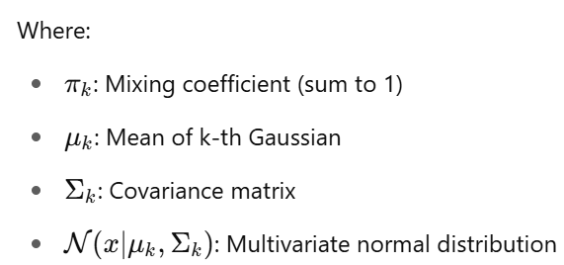
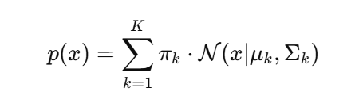
How Gaussian Mixture Models Work?
Here Each cluster is represented by a Gaussian distribution and the data points are assigned probabilities of belonging to different clusters based on their distance from each Gaussian.
🧠 Mathematical Formulation
A GMM models data as:

Slide 6
The Expectation-Maximization (EM) Algorithm
To fit a Gaussian Mixture Model to the data we use the Expectation-Maximization (EM) algorithm which is an iterative method that optimize the parameters of the Gaussian distributions like mean, covariance and mixing coefficients.
It works in two main steps:
Expectation Step (E-step): In this step the algorithm calculates the probability that each data point belongs to each cluster based on the current parameter estimates (mean, covariance, mixing coefficients).
Maximization Step (M-step): After estimating the probabilities the algorithm updates the parameters (mean, covariance and mixing coefficients) to better fit the data.
These two steps are repeated until the model converges meaning the parameters no longer change significantly between iterations.
Here’s a simple breakdown of the GMM process:
Initialization: Start with initial guesses for the means, covariances and mixing coefficients of each Gaussian distribution.
E-step: For each data point, calculate the probability of it belonging to each Gaussian distribution (cluster).

Slide 7
M-step: Update the parameters (means, covariance's, mixing coefficients) using the probabilities calculated in the E-step.
Repeat: Continue alternating between the E-step and M-step until the log-likelihood of the data (a measure of how well the model fits the data) converges.

Slide 8
Advantages of GMM
Flexible Cluster Shapes: Unlike K-Means which assumes spherical clusters it can model clusters with arbitrary shapes.
Soft Assignment: GMM assign a probability for each data point to belong to each cluster while K-Means assigns each point to exactly one cluster.
Handles Overlapping Data: GMM performs well when clusters overlap or have varying densities. Since it uses probability distributions, it can assign a point to multiple clusters with different probabilities
Limitations of GMM
Computational Complexity: GMM can take a lot of time and computer power especially when working with large datasets. because it uses a step-by-step method to keep improving its guesses about the data.
Choosing the Number of Clusters: Just like other clustering methods GMM needs you to decide how many groups you want to split the data into before starting.
But there are more methods like the Bayesian Information Criterion (BIC) and Akaike Information Criterion (AIC) can help in selecting the optimal number of clusters based on the data.

Slide 9
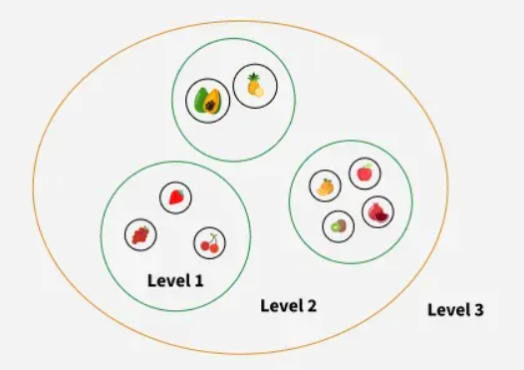
Hierarchical clustering
Hierarchical clustering is used to group similar data points together based on their similarity creating a hierarchy or tree-like structure.
The key idea is to begin with each data point as its own separate cluster and then progressively merge or split them based on their similarity.
Let’s understand this with the help of an example
Imagine you have four fruits with different weights: an apple (100g), a banana (120g), a cherry (50g) and a grape (30g). Hierarchical clustering starts by treating each fruit as its own group.
It then merges the closest groups based on their weights.
First the cherry and grape are grouped together because they are the lightest.
Next the apple and banana are grouped together.

Slide 10
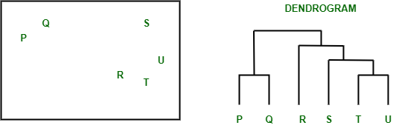
Dendrogram
A dendrogram is like a family tree for clusters. It shows how individual data points or groups of data merge together. The bottom shows each data point as its own group, and as you move up, similar groups are combined.
The lower the merge point, the more similar the groups are. It helps you see how things are grouped step by step. The working of the dendrogram can be explained using the below diagram:
In the above image on the left side there are five points labeled P, Q, R, S and T. These represent individual data points that are being clustered. On the right side there’s a dendrogram which show how these points are grouped together step by step.

Slide 11
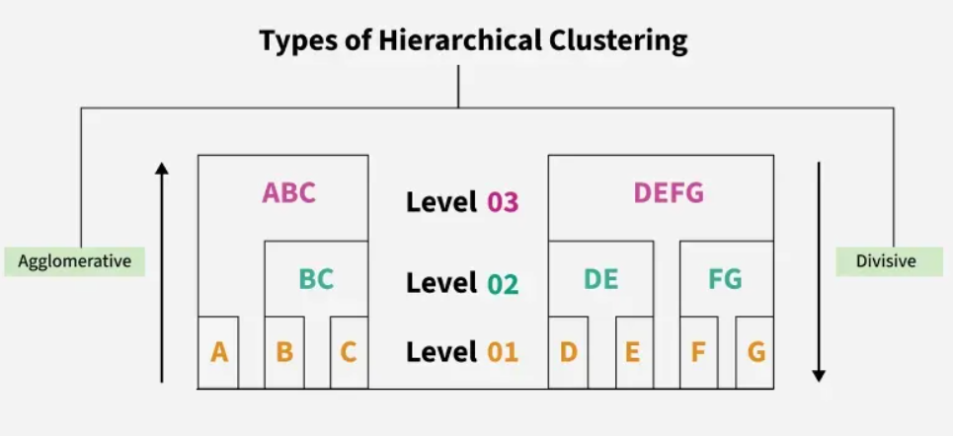
At the bottom of the dendrogram the points P, Q, R, S and T are all separate.
As you move up, the closest points are merged into a single group.
The lines connecting the points show how they are progressively merged based on similarity.
The height at which they are connected shows how similar the points are to each other; the shorter the line the more similar they are
Types of Hierarchical Clustering
There are two main types of hierarchical clustering.
Agglomerative Clustering
Divisive clustering

Slide 12
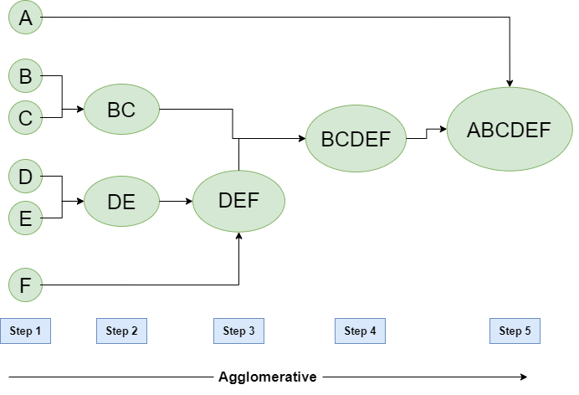
Hierarchical Agglomerative Clustering
It is also known as the bottom-up approach or hierarchical agglomerative clustering (HAC). Unlike flat clustering hierarchical clustering provides a structured way to group data.
This clustering algorithm does not require us to prespecify the number of clusters.
Bottom-up algorithms treat each data as a singleton cluster at the outset and then successively agglomerate pairs of clusters until all clusters have been merged into a single cluster that contains all data.

Slide 13
Workflow for Hierarchical Agglomerative clustering
Start with individual points: Each data point is its own cluster. For example, if you have 5 data points you start with 5 clusters each containing just one data point.
Calculate distances between clusters: Calculate the distance between every pair of clusters. Initially since each cluster has one point this is the distance between the two data points.
Merge the closest clusters: Identify the two clusters with the smallest distance and merge them into a single cluster.
Update distance matrix: After merging you now have one less cluster. Recalculate the distances between the new cluster and the remaining clusters.
Repeat steps 3 and 4: Keep merging the closest clusters and updating the distance matrix until you have only one cluster left.
Create a dendrogram: As the process continues you can visualize the merging of clusters using a tree-like diagram called a dendrogram. It shows the hierarchy of how clusters are merged.

Slide 14
Divisive Clustering
It is also known as a top-down approach. This algorithm also does not require to prespecify the number of clusters. Top-down clustering requires a method for splitting a cluster that contains the whole data and proceeds by splitting clusters recursively until individual data have been split into singleton clusters.
Workflow for Hierarchical Divisive clustering :
Start with all data points in one cluster: Treat the entire dataset as a single large cluster.
Split the cluster: Divide the cluster into two smaller clusters. The division is typically done by finding the two most dissimilar points in the cluster and using them to separate the data into two parts.
Repeat the process: For each of the new clusters, repeat the splitting process:
  Choose the cluster with the most dissimilar points.
  Split it again into two smaller clusters.
Stop when each data point is in its own cluster: Continue this process until every data point is its own cluster, or the stopping condition (such as a predefined number of clusters) is met.

Slide 15
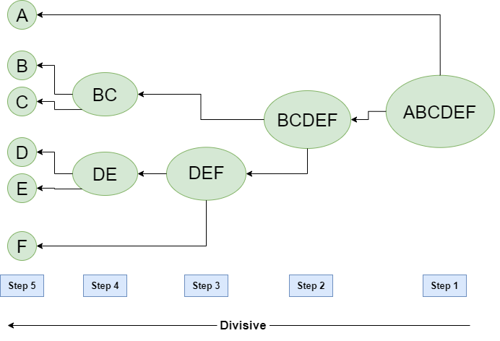
Hierarchical clustering is widely used unsupervised learning technique that organize data into a tree-like structure allow us to visualize relationships between data points using a dendrogram.
Unlike flat clustering methods it does not require a predefined number of clusters and provides a structured way to explore data similarity.

Slide 16
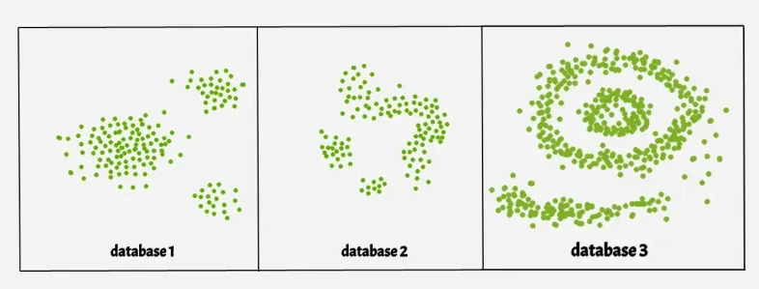
DBSCAN Clustering - Density based clustering
DBSCAN is a density-based clustering algorithm that groups data points that are closely packed together and marks outliers as noise based on their density in the feature space.
It identifies clusters as dense regions in the data space separated by areas of lower density.
Unlike K-Means or hierarchical clustering which assumes clusters are compact and spherical, DBSCAN perform well in handling real-world data irregularities such as:
Arbitrary-Shaped Clusters: Clusters can take any shape not just circular or convex.
Noise and Outliers: It effectively identifies and handles noise points without assigning them to any cluster.
DBSCAN Clustering in ML | Density based clustering

Slide 17
The figure above shows a data set with clustering algorithms: K-Means and Hierarchical handling compact, spherical clusters with varying noise tolerance while DBSCAN manages arbitrary-shaped clusters and noise handling.
Key Parameters in DBSCAN
eps: This defines the radius of the neighborhood around a data point. If the distance between two points is less than or equal to eps they are considered neighbors. A common method to determine eps is by analyzing the k-distance graph. Choosing the right eps is important:
  If eps is too small most points will be classified as noise.
  If eps is too large clusters may merge and the algorithm may fail to distinguish between them.
2. MinPts: This is the minimum number of points required within the eps radius to form a dense region. A general rule of thumb is to set MinPts >= D+1 where D is the number of dimensions in the dataset.

Slide 18
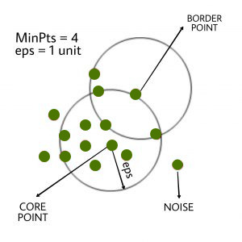
How Does DBSCAN Work?
DBSCAN works by categorizing data points into three types:
Core points which have enough neighbors within a specified radius (eplison)
Border points which are near core points but lack enough neighbors to be core points themselves
Noise points which do not belong to any cluster.
By iteratively expanding clusters from core points and connecting density-reachable points, DBSCAN forms clusters without relying on rigid assumptions about their shape or size.
For most cases a minimum value of MinPts = 3 is recommended.

Slide 19
Steps in the DBSCAN Algorithm
Identify Core Points: For each point in the dataset count the number of points within its eps neighborhood. If the count meets or exceeds MinPts mark the point as a core point.
Form Clusters: For each core point that is not already assigned to a cluster create a new cluster. Recursively find all density-connected points i.e points within the eps radius of the core point and add them to the cluster.
Density Connectivity: Two points a and b are density-connected if there exists a chain of points where each point is within the eps radius of the next and at least one point in the chain is a core point. This chaining process ensures that all points in a cluster are connected through a series of dense regions.
Label Noise Points: After processing all points any point that does not belong to a cluster is labeled as noise.

Slide 20
Meanshift
Meanshift is falling under the category of a clustering algorithm in contrast of Unsupervised learning that assigns the data points to the clusters iteratively by shifting points towards the mode (mode is the highest density of data points in the region, in the context of the Meanshift).
Mean-shift algorithm has applications in the field of image processing and computer vision.
As such, it is also known as the Mode-seeking algorithm.
The basic idea behind mean-shift clustering is to shift each data point towards the mode (i.e., the highest density) of the distribution of points within a certain radius.
The algorithm iteratively performs these shifts until the points converge to a local maximum of the density function. These local maxima represent the clusters in the data.

Slide 21
Mean Shift Steps : On a high level, Mean Shift works as follows:
Create a sliding window/cluster for each data-point
Each of the sliding windows is shifted towards higher density regions by shifting their centroid (center of the sliding window) to the data-points' mean within the sliding window. This step will be repeated until no shift yields a higher density (number of points in the sliding window).
Selection of sliding windows by deleting overlapping windows. When multiple sliding windows overlap, the window containing the most points is preserved, and the others are deleted.
Assigning the data points to the sliding window in which they reside.

Slide 22
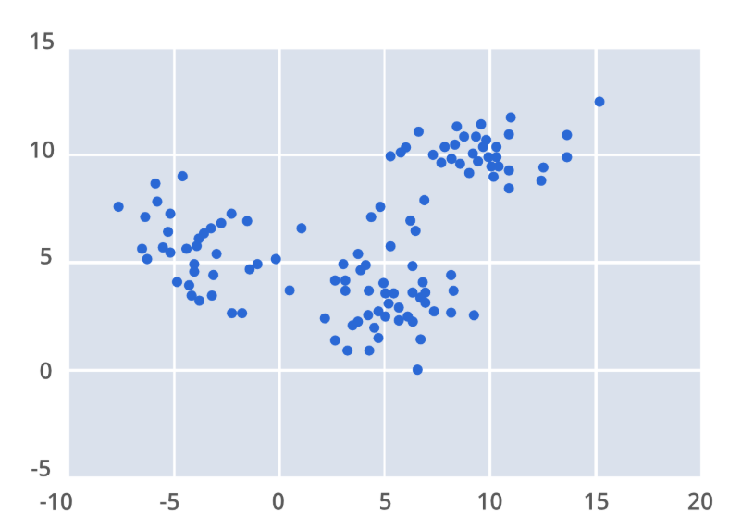
Kernel Density Estimation
The first step when applying mean shift clustering algorithms is representing your data in a mathematical manner this means representing your data as points such as the set below.
Mean-shift builds upon the concept of
kernel density estimation
kernel density estimation (KDE) is a method to estimate the underlying distribution also called the probability density function for a set of data.
It works by placing a kernel on each point in the data set.
A kernel is a fancy mathematical word for a weighting function generally used in convolution.

Slide 23
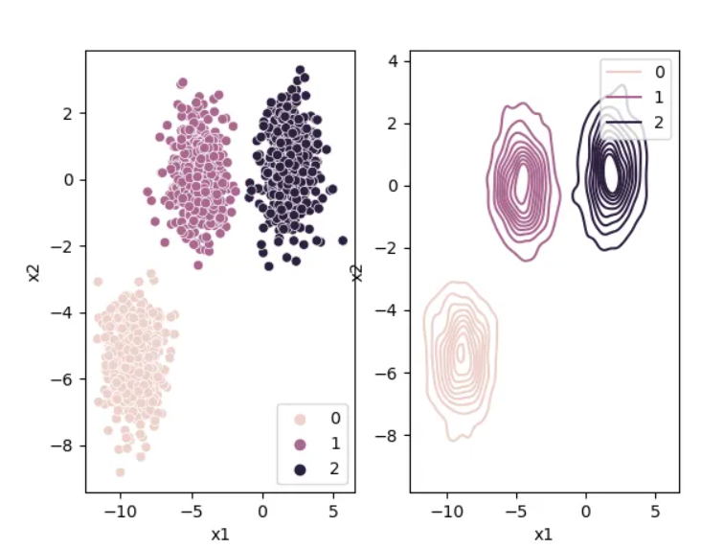
There are many different types of kernels, but the most popular one is the Gaussian kernel. Adding up all of the individual kernels generates a probability surface example density function.
Depending on the kernel bandwidth parameter used, the resultant density function will vary. Below is the KDE surface for our points above using a Gaussian kernel with a kernel bandwidth of 2.
Higher density regions correspond to regions with more data-points, and lower density regions correspond to regions with fewer points.
Mean Shift tries to find the high-density regions by continually shifting the sliding window closer to the peak of the region. This is also known as hill climbing

Slide 24
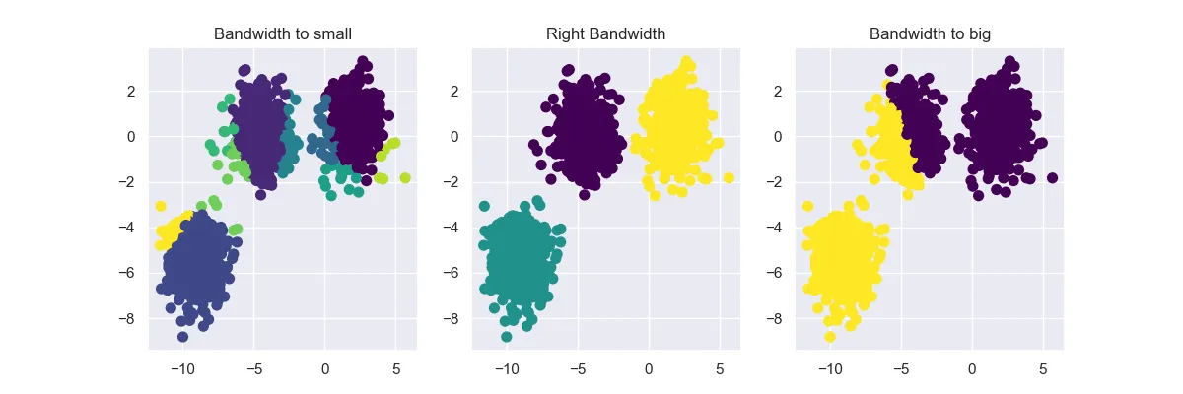
Choosing the right bandwidth / radius
Depending on the bandwidth, the resulting clusters can look quite different. As an extreme case, imagine that we choose an extremely small bandwidth. This will result in each point having its own cluster.
On the other hand, if we use a huge bandwidth, there will only be one cluster containing all the data-points.
Below you can see an image of different bandwidth values (not as extreme cases then mentioned above):

Slide 25
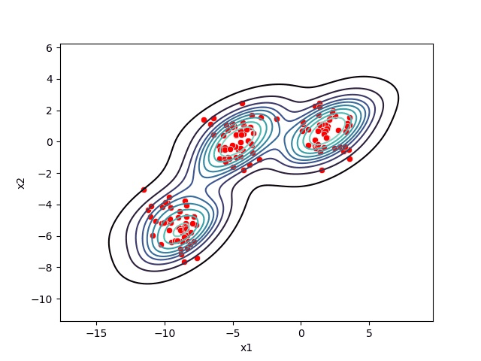

Slide 26
Advantages
Mean Shift is a simple cluster method that works very well on spherical-shaped data. Furthermore, it automatically selects the number of clusters contrary to other clustering algorithms like KMeans.
Also, the output of Mean Shift is not dependent on the initialization since, at the start, each point is a cluster.
Drawbacks
The algorithm is not highly scalable, as it requires multiple nearest neighbor searches during its execution. It has a complexity of O(n^2). Furthermore, manually choosing the bandwidth can be non-trivial, and selecting a wrong value can lead to bad results.
It also fails to find the correct clusters for some data-sets.

Slide 27
Cluster Validation Metrics
Cluster validation metrics are used to evaluate the quality of clustering results in unsupervised learning.
These metrics help you determine how well your clustering algorithm (like K-Means, DBSCAN, GMM, etc.) has grouped the data.
There are three types of cluster validation metrics:
1. Internal Validation Metrics
2. External Validation Metrics
3. Relative Validation
✅ 1. Internal Cluster Validation Metrics
These metrics do not require ground-truth labels and evaluate how well the clusters are formed based solely on the input data and cluster assignments. They're especially useful in unsupervised learning.

Slide 28
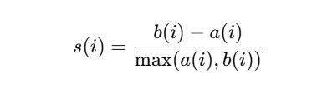
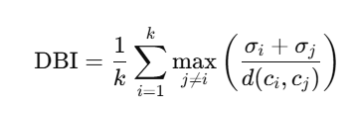
🔹 1. Silhouette Score
🔹 2. Davies-Bouldin Index (DBI)
Measures how similar a sample is to its own cluster vs. other clusters.
Measures average similarity between each cluster and the most similar one.
Formula:
Formula:
Where :
a(i) = mean distance between i and other points in the same cluster
b(i) = mean distance between i and points in the nearest cluster
Where :
  σi= average distance of cluster i's points to centroid
  d(ci,cj) = distance between centroids of clusters
  i and j
Lower is better
✔️ Use when: comparing multiple clustering configurations.
Range: -1 to +1
  Close to 1: well-clustered
  Around 0: overlapping clusters
  Close to -1: wrong clustering
✔️ Use when: clusters are convex and roughly equal in size.

Slide 29
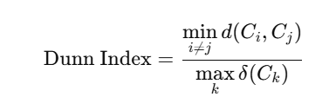
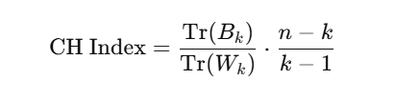
🔹 3. Calinski-Harabasz Index (CHI)
🔹 4. Dunn Index
Measures ratio between minimum inter-cluster distance and maximum intra-cluster diameter.
Also called the Variance Ratio Criterion. Measures how well-separated and compact the clusters are.
Formula:
Formula:
where:
where:
  Bk ​: between-cluster dispersion matrix
  Wk : within-cluster dispersion matrix
  N : number of data points
  K : number of clusters
Higher is better
✔️ Use when: cluster separation and compactness are both important.
d(Ci​,Cj​) : distance between clusters
δ(Ck) : diameter of cluster k
Higher is better
✔️ Use when: looking for compact and well-separated clusters.

Slide 30
🔹 5. Within-Cluster Sum of Squares (WCSS)
Measures the compactness of the clusters.
Often used with the Elbow Method to determine the optimal number of clusters.
Lower WCSS means clusters are more compact.
✅ 2. External Cluster Validation Metrics
External validation metrics compare the predicted cluster labels with true class labels (ground truth).
These are used only when you already know the true labels, such as in benchmarking or semi-supervised learning.

Slide 31
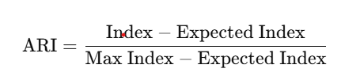
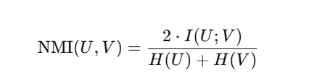
🔹 1. Adjusted Rand Index (ARI)
Measures the similarity between predicted clusters and ground truth, adjusted for chance.
🔹 2. Normalized Mutual Information (NMI)
Measures the mutual dependence between predicted labels and ground truth.
Formula:
Formula:
Where:
  I(U;V) : mutual information between clustering's
  H(U),H(V) : entropy of each clustering
Range: 0 to 1
  1 → perfect match
  0 → no mutual information
✔️ Use when clusters are of unequal size or not uniformly distributed.
Range: -1 to 1
  1 → Perfect match
  0 → Random labeling
  < 0 → Worse than random
✔️ Use when you care about pairwise agreements (e.g., A and B in the same cluster in both true and predicted).

Slide 32
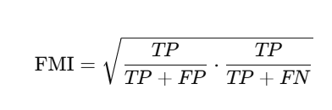

🔹 3. Fowlkes–Mallows Index (FMI)
🔹 4. Homogeneity, Completeness, and V-Measure
Measures the geometric mean of precision and recall for cluster pairs.
These three metrics form a composite evaluation.
Homogeneity: Each cluster contains only members of a single class
Completeness: All members of a given class are assigned to the same cluster
V-Measure: Harmonic mean of the above two
Formula:
where:
  TP = true positives (same cluster in both true
  and predicted)
  FP = false positives
  FN = false negatives
Range: 0 to 1 (Higher is better)
✔️ Use when you want a balance between precision and recall for clustering.
✔️ Use when you want interpretable, class-specific cluster quality.

Slide 33
✅ 3. Relative Cluster Validation Metrics
Relative validation helps you compare clustering results across different configurations (e.g., different numbers of clusters k) to choose the optimal number of clusters.
Unlike internal or external metrics, relative validation doesn't give a score in isolation — it helps you decide "which model is better?"
🔹 1. Elbow Method (Using WCSS)
WCSS: Within-Cluster Sum of Squares
Measures the total variance within each cluster.
Process:
  Run K-Means (or similar) for various kkk values.
  Plot kkk vs. WCSS.
  Look for the "elbow point" where the rate of WCSS reduction slows.
Goal: Find the smallest kkk that gives you the most gain in compactness.
✅ Ideal for:
K-Means clustering
Well-separated, spherical clusters

Slide 34
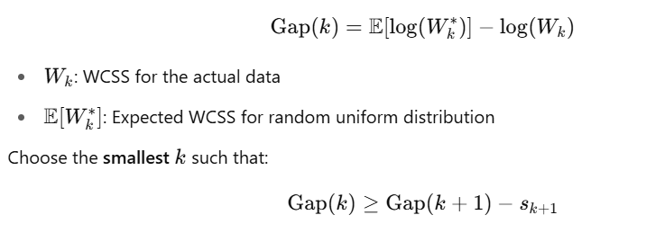
🔹 2. Gap Statistic
Compares the observed WCSS with WCSS expected under random (null) reference distribution.
Formula:
Choose the smallest k such that:
Gap(k)≥Gap(k+1)−sk+1​ where sk is the standard deviation.
✅ Ideal for:
Preventing overfitting in choosing k
Any clustering algorithm

Slide 35
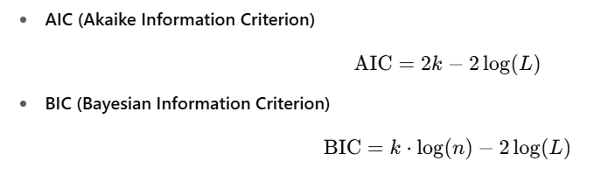
🔹 3. Information Criteria (AIC/BIC)
Used in probabilistic models like Gaussian Mixture Models (GMM).
where:
  k = number of parameters
  n = number of data points
  L = likelihood
Lower values are better
✅ Ideal for:
Gaussian Mixture Models
Clustering with statistical models
🔹 4. Silhouette Analysis Over k
Silhouette score (internal metric) plotted for different k values to visually inspect the best k.
Choose k with maximum silhouette score.

